Slide 1
CARDIAC CHANNELOPATHIES
Dr Nijin Jose
SR Cardiology
Calicut Medical College

Slide 2
References
BRAUNWALD’S HEART DISEASE A TEXTBOOK OF CARDIOVASCULAR MEDICINE, 12th edi
CLINICAL ARRHYTHMOLOGY AND ELECTROPHYSIOLOGY A COMPANION TO BRAUNWALD’S HEART DISEASE, 3rd edi
2017 AHA/ACC/HRS Guideline for Management of Patients With Ventricular Arrhythmias and the Prevention of Sudden Cardiac Death
Uptodate
An Update on Channelopathies From Mechanisms to Management Gregory Webster, MD; Charles I. Berul, MD. Circulation. 2013;127:126-140.
Prevalence and Prognostic Role of Various Conduction Disturbances in Patients With the Brugada Syndrome Philippe Maury, Am J Cardiol. 2013;112:1384–1389. doi: 10.1016/j.amjcard.2013.06.033.

Slide 3
Pharmacological treatment of congenital LOTS
Calcium channel blocker
Amiodarone
Beta blocker
Procainamide

Slide 4
ERS with high risk for arrhythmias
Type 1
Type 2
Type 3

Slide 5
Drug to be avoided in brugada syn
Quinidine
Amiodarone
Procainamide

Slide 6
Cardiac sodium channel overlap syndrome—doesnot include
LQTS
Brugada syn
Sinus node dysfunction
Progressive cardiac conduction disorder

Slide 7
Phase 0 of action potential –predominant current
Na into cytoplasm
Na out of cytoplasm
K into cell
K out of cell

Slide 8
Predominant channel maintaining resting membrane potential
NaK ATPase
slowly activating delayed rectifier cardiac potassium channel (I Ks)
rapid delayed rectifier potassium channel (I Kr)
Funny current (I f)

Slide 9
Arrhythmogenic disease due a genetic abnormality that results in dysfunction of a cardiac ion channel
Also known as inherited arrhythmogenic diseases (IADs).

Slide 11
Phases of action potential
Phase 0/depolarization--Fast Na channel—Na into cytoplasm
Phase 1 / initial repolarization--K to outside
Phase 2 / plateau--Calcium influx and K efflux
Phase 3 / late repolarization-- K efflux, Cal influx stops
Phase 4 / resting potential—NaK ATPase (2 K in for 3 Na out), Na Ca exchanger (3 Na in for 1 cal out )

Slide 12
Sodium channelopathies
Long QT syndrome
Brugada syndrome
Early repolarization syndrome
Progressive cardiac conduction disease
Congenital sick sinus syndrome
Atrial stand still
Familial AF
Dilated cardiomyopathy
Sudden infant death syndrome

Slide 13
Potassium channelopathy
Long qt syndrome
Andersen tawil syndrome
Brugada syndrome
Short QT syndrome
Early repolarization syndrome
Catecholaminergic polymorphic VT
Familial atrial fibrillation

Slide 14
Channelopathies in calcium regulation
Long Qt syndrome
Timothy syndrome
Triadin knockout syndrome
Brugada syndrome
Short qt syndrome
Early repolarization syndrome
Catecholinergic polymorphic ventricular tachycardia
Idiopathic ventricular fibrillation

Slide 15
Long QT syndrome

Slide 16
Long QT Syndrome
characterized by delayed repolarization of ventricular myocardium resulting in heart rate corrected QT (QTc) prolongation > 480ms – increased risk of –
Syncope
Seizures
Sudden cardiac death
--------------------------- in a setting of structurally normal heart

Slide 17
Inheritance→
Autosomal dominant –most common
Autosomal recessive -- Jervell and Lange Nielsen syndrome
Incidence 1 in 2500

Slide 18
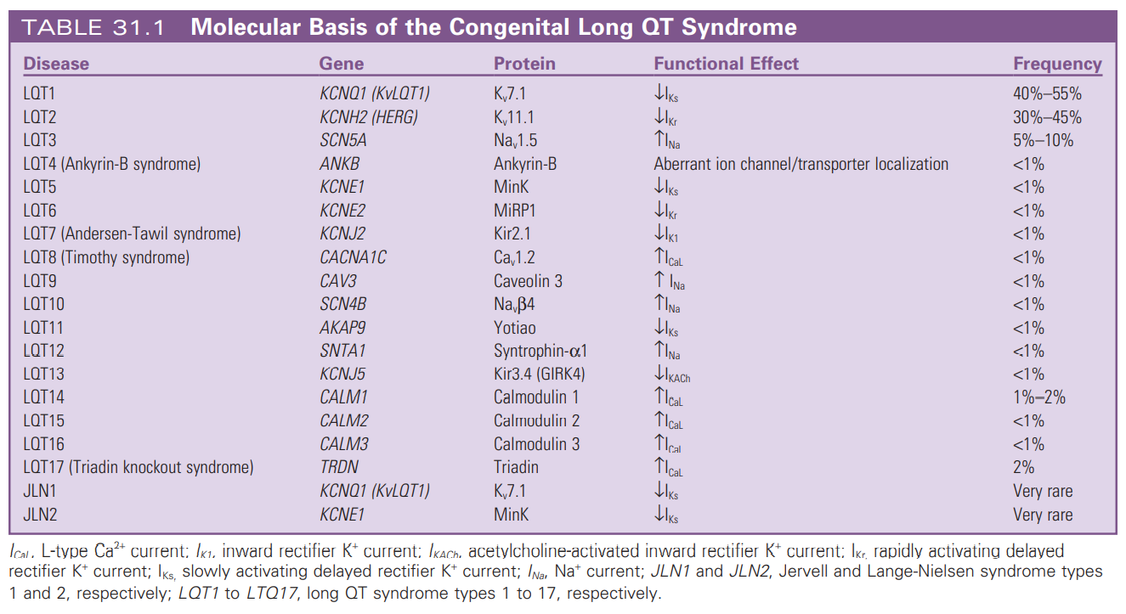

Slide 19
Potassium Channel LQTS
Potassium channel derangements account for majority of LQTS cases : Long QT 1, 2, 5, 6, 7 and 13.
IKs : slowly activating delayed rectifier cardiac potassium channel
α subunit is encoded by KCNQ1
β subunit is encoded by KCNE1
Loss of function mutation result in LQT 1 and LQT 5
Ikr : rapid delayed rectifier potassium channel
α subunit encoded by KCNH2
β subunit encoded by KCNE2
Loss of function mutation result in LQT 2 and LQT 6.

Slide 20
: another inwardly rectifying K+ channel
encoded by gene KCNJ2
Loss of function mutation result in LQT 7 (Tawil-Anderson syn)
^{I}KI
KCNJ5 mutation which is a loss-of-function mutation in an inwardly rectifying potassium channel result in LQT 13

Slide 21
Sodium channel LQTS
α subunit of sodium channel is encoded by SCN5A and β subunit
encoded by SCN4B.
Gain of function mutations in SCN5A produce LQT3.
Mutations in SCN4B produce LQT10.

Slide 22
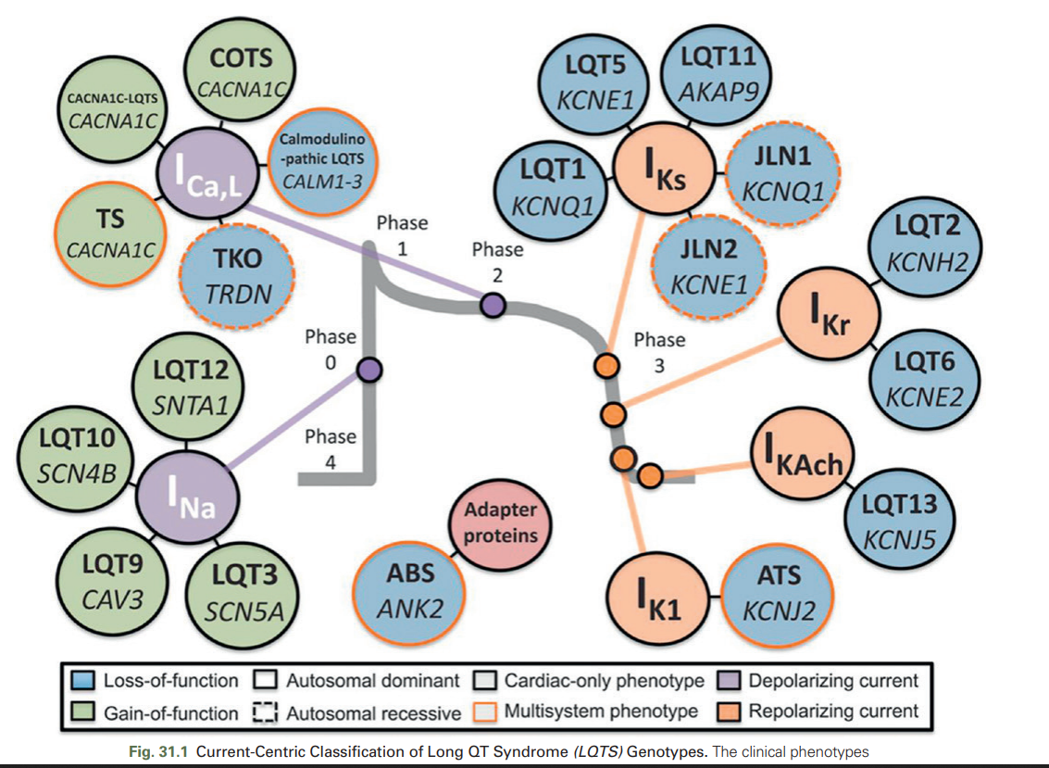
Molecular basis for long QT syndrome
Topol EJ, Califf RM et al

Slide 23
Pathophysiology of LQTS
Prolonged repolarization results fm net reduction in outward current, due to ↑ in inward Na + or Ca + current, ↓ in outward K+ current or both resulting in long QT interval.
Fast heart rate preceding TdP in LQT1 postulate delayed afterdepolarizations (DADs) as its arrthymogenic mechanism.
Increased Ca+ loading in parallel with QT prolongation, facilitate DADs and DAD-dependent TdP.
Pause-dependent TdP is triggered by early afterdepolarizations
(EADs).
Pause leads to enhanced Ca+ release from intracellular stores and
activate Ca+ dependent transmembrane currents.

Slide 24
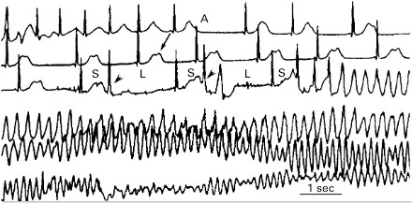
Initiation of arrhythmia in LQTS
Non-pause dependent torsade de pointes
Mainly in LQT1
Pause dependent torsade de pointes
Mainly in LQT2

Slide 25
Clinical features
May be asymptomatic
Symptomatic pts present with palpitations, presyncope, syncope or cardiac arrest.
Neuronal deafness is associated with Jervell and Lange-Nielsen syndrome
In a study on 287 pts , 61% were symptomatic : 9% presented with a cardiac arrest, 26% with syncope ,10% with seizures , 6% had presyncore or palpitation
67% had symptoms related to exercise, 18% had symptoms during exercise and with emotion, 7% with emotion alone, 3% with loud noise and exercise and 2% with anesthesia.
A Garson, M Dick et al Circulation. 1993;87:1866-1872

Slide 26
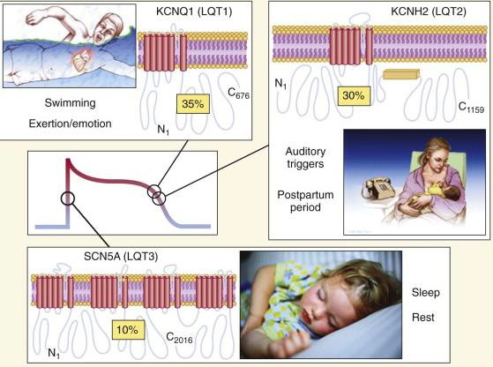
Triggers of arrhythmia
Triggers include exercise, noise, emotion, sudden wakening from
sleep by noise , swimming or diving.
Swimming and exertion-induced cardiac events are strongly associated with LQT1.
Auditory triggers and events
during postpartum period occur in pts with LQT2.
Events occurring during periods of sleep or rest are most common in
LQT3.

Slide 27
Jervell and Lange-Nielsen syndrome
Autosomal recessive variant of long QT syndrome.
Due to homozygous or compound heterozygous mutations on either the KCNQ1 or KCNE1 genes.
Pts also suffer from congenital deafness.
Most severe of major variants of LQTS.
90% have cardiac events, 50% become symptomatic by
age of 3 yrs and their average QTc is markedly prolonged (557± 65 ms)

Slide 28
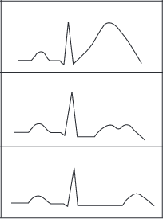
ECG in LQTS
QTc values exceeding 440 ms (in males) and 460 ms (in females) are considered abnormal .
LQT1 is associated with a broad-based T wave.
LQT2 with low-amplitude notched or
biphasic T wave.
LQT3 with long isoelectric segment followed by a narrow-based T wave.

Slide 29
Clinical features of LQTS
 | LQT1 | LQT2 | LQT3
 | KCN Q1 encoded I_{ks} potassium channel loss of function | KCNH2 encoded Ikr potassium channel loss of function | SCN5A encoded Ina sodium channel gain of function
 | swimming and exertion induce cardiac arrhythmia emotional stress induced | auditory triggers and in post partum | during rest / sleep
 |  | Male female ratio→ Childhood—M=F Adulthood—F>M.
 | Broad base T wave | Low amplitude notched or biphasic T wave | Long isoelectric segment followed by a narrow based T wave
Beta blocker efficacy | Extremely protective | Moderate protection | Moderate protection
Specific agents |  |  | Late sodium current blockers→ Mexiletine Flecainide Ranolazine

Slide 30
LQTS : Diagnostic Criteria
Score
≤1 point: low probability
1.5–3 points: intermediate probability
≥3.5 points: high probability.
Schwartz et al
Circ Arrhythm Electrophysiol. 2012;

Slide 31
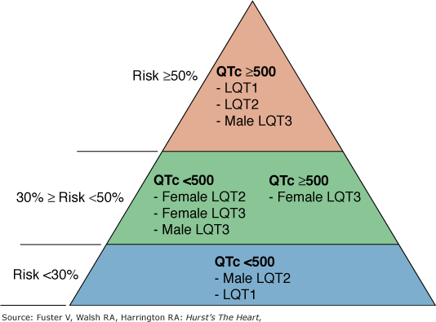
Risk stratification
Risk of a 1st cardiac event in pts younger than 40 years of age in the absence of any LQTS active treatment

Slide 32
Treatment
All LQTS pts with h/o syncope and asymptomatic individuals with definite QT prolongation should be treated withβ-blockers
Drugs used are Propranolol ( 2-4 mg/kg/d),
Nadolol (1-2.5 mg/kg/d)
Metoprolol (2-4 mg/kg/d)
Dose titration done with a target of 25% to 35% reduction of maximal heart rate attained on therapy.
Left Cardiac Sympathetic Denervation may be considered in
symptomatic patients even after betablocker therapy.

Slide 33
Treatment
ICD implantation along with β -blockers is recommended for LQTS patients with previous cardiac arrest or who are experiencing syncope and/or VT while receiving beta blockers.
Permanent pacing is indicated for sustained pause-dependent VT, with or without QT prolongation.
Avoid competitive sports, QT-prolonging drugs and lowered K+
levels .

Slide 34
β-blocker therapy in LQTS
β-blocker therapy results in 42% to 78% reduction of aborted cardiac arrest or sudden cardiac death.
β-blocker is most efficacious in LQT1 and less effective in LQT3.
In LQT3, combination of mexiletine with a noncardioselective β- blocker (propranolol ) is used .

Slide 35
Brugada syndrome

Slide 36
Spontaneous / class 1 anti arrhythmic provoked
coved type ST segment elevation >/= 2 mm followed by a negative T wave of >/= 1 mm
In right precordial leads (V1-V2) on ECG
increased risk of SCD during rest, sleep or febrile episode
right ventricular outflow tract epicardium structural abnormality

Slide 37
Genetic basis
AD with incomplete penetrance and variable expressivity

Slide 38
Genes Involved in Brugada
CHANNELOPATHY | GENE | CHANNEL/PROTEIN | Effect
BrS 1 | SCN5A | Cardiac sodium channel α subunit | ↓ Na⁺ current
BrS 2 | GPD1L | Glycerol-3-phosphate dehydrogenase | ↓ Na⁺ current
BrS 3 | CACNA1C | L-type calcium channel α subunit | ↓ Ca²⁺ current
BrS 4 | CACNB2 | L-type calcium channel β subunit | ↓ Ca²⁺ current
BrS 5 | SCN1B | Cardiac sodium channel β₁ subunit | ↓ Na⁺ current
BrS 6 | KCNE3 | Transient outward current β subunit | ↑ K⁺ Ito current
BrS 7 | SCN3B | Cardiac sodium channel β₃ subunit | ↓ Na⁺ current

Slide 39
Pathophysiology
Increased outward shift in current during early phase of action potential in RVOT→
Decreased I Na, I CaL
Increased I to (transient outward K current)

Slide 41
Repolarization hypothesis
difference in distribution of I to current (RV >LV, epicardium > endocardium)
Transmural voltage gradient during early repolarization in ventricle→ J wave / j point elevation
Na channel malfunction—accentuates notch produced by I to→ partial or complete loss of AP dome→ premature repolarization and shortening of AP duration
These changes are more in RVOT epicardium→ J point elevation, slurring of terminal QRS, mild ST segment elevation
Further increase in net repolarization current → complete loss of AP dome in RVOT epicardium→ epicardial repolarization precedes endocardial repolarization
Transmural dispersion of repolarization—reentrant excitation waves between endocardium and epicardium→ polymorphic VT/VF

Slide 42
Common in southeast Asia
AD with incomplete penetration
M:F—8:1
Age of onset of symptoms—3rd-4th decade

Slide 43
Clinical features
Asymptomatic 60%
Syncope –33%
Supraventricular arrhythmias (20%)—mainly AF 10-20%, AVNRT, WPW syndrome
Cardiac arrest secondary to polymorphic VT/VF--<10%
Rare→
Sinus node dysfunction
AV conduction abnormalities and interventricular conduction blocks—SCN5 mutation

Slide 44
Triggers→
Sleep -- early morning
Large meals—gastric distention
Alcohol
Cocaine toxicity
Drugs
Fever

Slide 45
Ecg
Type 1 | Type 2 | Type 3
ST elevation of 2mm with a downward convex + incomplete / complete RBBB Followed by negative T wave with little or no isoelectric separation | Saddle back appeance High take off ST segment elevation of atleast 2mm trough displaying a ST elevation of >1mm positive / biphasic T wave | Saddle back or coved apperance of ST segment elevation <1mm
Type 1 pattern is diagnostic of brugada syndrome | Type 2 or 3—suggestive not specific

Slide 47
Other ECG findings→
QT prolongation especially in right precordial leads
QRS fragmentation—multiple small spikes within the QRS complex—40% cases
Seen in 85% case with history of VF episode
Multiple breaks are due to arrhythmogenic substrates
3. PR prolongation

Slide 49
Drug challenge
Done in pts with resting ECG type 2 or 3 Brugada pattern and having family h/o sudden cardiac death at < 45 yrs and/or a family h/o type 1 Brugada pattern ECG
Drugs used
Flecainide : 2 mg/kg over 10 min iv or 400 mg PO
Procainamide : 10 mg/kg over 10 min iv Ajmaline : 1 mg/kg over five minutes iv Pilsicainide : 1 mg/kg over 10 minutes iv

Slide 50
Drug challenge
Indications for termination of the drug challenge include:
Development of a diagnostic type 1 Brugada pattern
≥2 mm increase in ST segment elevation in pts with type 2 Brugada ECG pattern
Development of ventricular premature beats or other arrhythmias
Widening of the QRS ≥30 percent above baseline

Slide 51
Causes of Brugada like pattern
Acute causes | Persistent causes
Acute pericarditis / myocarditis Acute MI Pulmonary embolism Prinzmetals angina Dissecting aortic aneurysm Hypothermia Post defibrillation | Atypical RBBB LVH Early repolarization Athletes heart Duchene muscular dystrophy Friedrich’s ataxia Spinomuscular atrophy Arrhythmogenic RV dysplasia Chaga’s disease Mechanical compression of RVOT

Slide 52
Brugada : Diagnostic criteria
Appearance of type 1 ST segment elevation (coved type) in > 1 rt precordial lead (V1 - V3) in the presence or absence of a sodium channel blocker, plus at least one of the following:
Documented ventricular fibrillation.
Polymorphic ventricular tachycardia (VT).
Family h/o sudden cardiac death at less than 45 years of age.
Family h/o of type 1 Brugada pattern ECG changes.
Inducible VT during electrophysiology study.
Unexplained syncope.
Nocturnal agonal respiration .
Type 2 and type 3 ECG are not diagnostic of Brugada syndrome
Second Consensus Conference : Europeon Heart Rhythm Society

Slide 53
Treatment
ICD
Pharmacological treatment
Quinidine 1 to 1.5 g/day of quinidine sulfate or 600 to 900 mg/day of hydroquinidine
Amiodarone 400mg BD or TID x 1-2 weeks→ 200mg /day
Aggressive treatment of fever
Participation in sports-→
Asymptomatic—no restriction
History of symptoms, at present asymptomatic for 3 months on treatment—no restriction
Avoid dehydration and hyperthermia

Slide 55
Short QT syndrome
Ultrashort QT (<320ms) with peaked T waves in precordial leads often with early repolarization changes

Slide 57
Short QT <320ms, paroxysmal AF, syncope and increased risk of SCD
Syncope and cardiac arrest during rest or sleep

Slide 59
Pathophysiology
Difference in shortening of action potential across thickness of myocardium—more shortened in epicardium and endocardium—increased risk of re-entry circuit in atrium and ventricle

Slide 60
Incidence
M:W 3:1--Risk of cardiac arrest M=F
Age of presentation—infancy to elderly
Mean age==20-30yrs
Cardiac arrest incidence—
1st peak—1st year of life
2nd peak—20-40yrs
Family history of SQTS / SCD 72%

Slide 61
Clinical features-→
Cardiac arrest 33%
AF 30%
Syncope 14%
Event during sleep / rest

Slide 62
ECG→
QT <320 (QTc <340)
Tall peaked T waves with short / absent ST segment
T is symmetric in SQT1
T is asymmetric in SQT2-4
T is inverted in SQT2
BrS like ST elevation in V1V2—SQT-5

Slide 63
Gallob score
probablity
=/> 4—high
3—intermediate
</= low

Slide 64
Treatment
Class 1 | Asymptomatic—observation
Class 1 | Symptomatic—ICD
Class 2a | SQT syn with recurrent / sustained VA—quinidine
Class 2a | SQT syn with electrical strom—isoprenaline infusion

Slide 65
Treatment
Disopyramide and amiodarone has shown to increase QT
Universal restriction from competitive sports

Slide 66
Catecholaminergic polymorphic ventricular tachycardia

Slide 67
Calcium and pathogenesis of CPVT
Calcium induced calcium release
Systole→
Calcium influx into cell via L type calcium channel during Action potential plateau trigger more massive Calcium release from Sarcoplasmic reticulum into cytosol via RYR2 → Increased cytosolic calcium→ calcium binds to troponin C → contraction
Diastole→
Calcium in cystole pumped into Sacroplasmic reticulum by sarcoplasmic / endoplasmic reticulum calcium ATPase—controlled by phosphoprotein phospholamban
Small amount of calcium→ out of cell by Na Cal exchange

Slide 68
RYR-2 mutation—diastolic calcium leak into cystole during diastole
Calsequestrin—Ca storage protein into Sarcoplasmic reticulum→ binds to calcium during diastole—calsequestrin mutation – spontenous calcium release during diastole
Calmodulin—bind to RYR2 -- mutation causes –excessive calcium release via RYR2
increased cytosolic calcium—activation of Na Ca exchange→ net inward current (transient inward current) → depolarization

Slide 69
beta adrenergic stimulation—
increased calcium into cell via L type Calcium
increased storage of Calcium into sarcoplasmic reticulum

Slide 70
Highly malignant inherited arrhythmia characterized by exercise or stress induced polymorphic / bidirectional VT
1:10000
Exercise induced syncope / sudden death in otherwise structurally normal heart
ECG at rest—bradycardia and subtle U waves
Exercise stress test / catecholamine provocation test—bidirectional VT – more specific
More sensitive—exercise induced premature ventricular complexes in bigeminity
Age of first presentation infancy-40yrs
Positive family history of SCD 1/3rd

Slide 71
Progressive worsening of arrhythmia with increasing exercise workload
SR rate 110-130→ monophorphic VPC→ polymorphic VPC→ bigeminity, couplets→ non sustained Vt-→ bidirectional VT→ polymorphic VT→ VF
Disappearance in the first minute of recovery

Slide 73
Treatment
Beta blockers
Further episodes on maximum tolerated betablockers→ flecainamide / verapamil added +/- ICD
Catheter ablation
Left cervicothoracic sympathectomy—T1-T4→ succus rate 90%--> indication—after adequate pharmacotherapy
Participation in sport – not allowed

Slide 74
Early repolarization syndrome

Slide 75
J point elevation >/= 1mm above baseline¹→ manifests as—
QRS slurring at the transition of the QRS to the ST segment¹
Notching – a positive deflection inscribed on terminal S wave¹
ST segment elevation with upper concavity and prominent T waves in >/= 2 contigous leads¹
Incidence 1-13%¹
Common in—
children and young adults
African American and south east Asian
Men
Atheletes—due to increased vascular tone

Slide 77
Ito channel more common in ventricular epicardium than endocardium→ epicardial action potential when compared to endocardial action potential—
Shorter duration
Prominent phase 1 notch
Spike and dome morphology
This voltage gradient between epicardium and endocardium→ leads to normal J wave in ECG
Increased J wave / ST elevation→ due to net outward shift of current—
Increased outward K current—Ito, Ikr, Iks, Kach, Katp
Decreased inward current—Ina, I CaL

Slide 78
J wave in EPS increases markedly just before arrhythmogenic event (hallmark of disease)
increased outward shift in current—partial or complete loss the dome of AP in epicardium→ loss of activation of I CaL→ dome of AP propagates from region where it is present (mid myocardium and endocardium) → to region where it is absent (epicardium)→leads to phase 2 re-entry
short coupled PVCs—falling on descending limb of T wave (R on T phenomenon)→ trigger transmural re-entry and polymorphic VT/ VF
J wave can be increase in hypothermia—hence arrhythmogenicity increases in hypothermia

Slide 79
Clinical features→
Asymptomatic
Idiopathic VF

Slide 80
Ecg
QRS ST segment elevation >/= 0.1mV in =/> 2 contigous inferolateral leads (1, 2, 3, avL, avF, V4-V6)
Types of J point elevation→
Slurring—smooth transition
Notching—positive deflection in S wave
ST segment after J point-- types→
ER with horizontal ST segment
ER with descending ST segment
ER with ascending ST segment—upsloping ST segment

Slide 82
Types of ERS according to risk of arrhythmias
Type 1 | Lateral leads V4-V6 | Low risk
Type 2 | Inferior or inferolateral leads | High risk
Type 3 | Inferior, lateral and right precordial leads | Very high risk

Slide 84
2017 AHA/ACA guidelines
Asymptomatic patient observation | Class 1
History of cardiac arrest / VT/VF—ICD is indicated | Class 1

Slide 85
Idiopathic ventricular fibrillation

Slide 86
Resuscitated cardiac arrest victim with documented VF in whom cardiac, respiratory, metabolic and toxicological etiologies has been excluded
Diagnosis of exclusion
Genetics→
DPP6—dipeptidyl peptidase 6 – age of onset 20-60—autosomal dominant
CALM1—calmodulin
RYR2—ryanodine receptor

Slide 87
Pathophysiology
Short coupled interval (R on T phenomenon) originating from RVOT or HIS purkinjee system—Phase 2 re-entery → ventricular fibrillation

Slide 88
Clinical features→
Age of presentation 35-45 yrs
2/3 men
Positive family history in 20%
Cardiac arrest > syncope
Occurs mainly in sleep and at increased vagal tone—2 peaks—early morning and late evening
Electrical storm—10% cases

Slide 89
ECG→
most common normal ECG
J point elevation just before VF—then J point elevation normalizes

Slide 90
Principles of management
Quinidine
Beta agonists
Amiodarone – limited efficiency
Not beneficial→ beta blockers, lidocaine, mexilectine, verapamil
Control of VF→
Increase HR to 120—by isoproterenol infusion
Deep sedation
Prophylaxis→ ICD – who had prior cardiac arrest
Catheter ablation—monomorphic PVCs
Restricted from sports

Slide 91
2017 AHA/ASA guideline
Resuscitated sudden cardiac death due to idiopathic VT/VF-- ICD | Class 1
Persistent shocks – catheter ablation | Class 1

Slide 92
Andersen Tawil syndrome
Incidence <1 in 10 lakh
Autosomal dominant
Clinical triad→
Periodic paralysis
Frequent ventricular ectopy/ arrhythmias
Variable developmental abnormalities→ Micrognathia, Low set ears, Widely spaced eyes, Clinodactyly
Has normal QT interval
Typical ATS-- >2 ATS features
Atypical ATS—only1 ATS feature—cardiac manifestations only

Slide 93
Genetics
Loss of function mutation of KCN J2→ Kir2.1—causes→ inward rectifying cardiac I_{Ki}
2 membrane spanning repeat K channel alpha subunit

Slide 94
ECG abnormality→
Ventricular bigeminity
Polymorphic VT
Bidirectional VT
life time risk of SCA/ SCD—9.3%

Slide 95
Ankyrin B syndrome / sick sinus syndrome with bradycardia
ANK-2 gene—encodes ankyrin B protein
anchors various protein into cytoskeleton
Cardiac arrhythmias→
Atrial arrhythmias—AF, sinus bradycardia
Modest QTc prolongation
Catecholamine induced ventricular arrhythmias
High risk of SCD
Sinus node dysfunction
Delayed cardiac conduction block
Drug induced long QT syndrome
Exercise induced VT

Slide 96
Timothy syndrome
Very rare multisystem highly lethal arrhythmic disorder associated with cardiac and extracardiac manifestations
Cardiac manifestation—
fetal bradycardia
extreme prolongation of QT >500msec often with microscopic T wave alternans
2:1 atrioventricular block at birth
Congenital heart defects or cardiomyopathy
Death before attaining puberty
Extracardiac manifestations—
Syndactyly—webbing of the toes and fingers
Dysmorphic facial features
Abnormal dentition
Immune deficiency
Severe hypoglycemia
Developmental delay including autism

Slide 97
Genetic basis→
CACN A1C—gain of function mutation
cardiac L-type calcium channel

Slide 98
Triadin knockout syndrome
abnormal functioning of RYR2, L type calcium channel→ calcium overload in sarcoplasmic reticulum
Autosomal recessive
Presents during childhood
Associations→Proximal skeletal myopathy
Transient / consistent QT prolongation with extensive precordial (V1-V6) T inversions
severe and refractory exercise induced ventricular arrhythmia

Slide 99
Idiopathic SSS
Sinus node dysfunction without identifiable cardiac abnormalities
Clinical features→
Inappropriate bradycardia^{1,2}
Sinus arrest^{1,2}
Atrial stand still^{1,2}
Tachycardia-bradycardia syndrome
Chronotrophic incompetence
Sinoatrial blocks²
Inheritance→Autosomal dominant with reduced penetrance
Recessive form with complete penetrance

Slide 100
Genetic mutations→
SCN 5A^{1,2}—non functional sodium channel
HCN 4—I_{f} / funny or pacemaker current defect
ANK2 mutation—defect in ankyrin B
MYH6—codes for alpha heavy chain 6 subunit of cardiac myosin
Mechanisms→
Reduced peak I^{Na} density²
Slow recovery from action potential²
Leads to—reduced automaticity, decreased excitability and conduction slowing / blocks²

Slide 101
Cardiac sodium channel overlap syndrome
Loss of function SCN5A
brugada syndrome +
sinus node dysfunction +
progressive cardiac conduction disorder

Slide 102
Pharmacological treatment of congenital LOTS
Calcium channel blocker
Amiodarone
Beta blocker
Procainamide

Slide 103
ERS with high risk for arrhythmias
Type 1
Type 2
Type 3

Slide 104
Drug to be avoided in brugada syn
Quinidine
Amiodarone
Procainamide

Slide 105
Cardiac sodium channel overlap syndrome—doesnot include
LQTS
Brugada syn
Sinus node dysfunction
Progressive cardiac conduction disorder

Slide 106
Phase 0 of action potential –predominant current
Na into cytoplasm
Na out of cytoplasm
K into cell
K out of cell

Slide 107
Predominant channel maintaining resting membrane potential
NaK ATPase
slowly activating delayed rectifier cardiac potassium channel (I Ks)
rapid delayed rectifier potassium channel (I Kr)
Funny current (I f)

Slide 108
Thank you

